Slide 1
City Manager's Monthly Update
November 21, 2023

Slide 2
City Manager's Monthly Update
Development
Projects
Financial
Miscellaneous

Slide 3
Development
Residential
  Single Family
  Multi-Family
Commercial
Short Term Rentals
Comprehensive Plan

Slide 4
COMPREHENSIVE PLAN
October 2023
Task/Meeting | Date | Notes | Status
Parks Plan draft to City |  | City review for ~2-3 weeks | Complete
November 2023
Task/Meeting | Target Date | Notes | Status
TRIP - CPAC #5 - Review Parks Master Plan | Nov 14 | Second draft to CPAC | Complete
Comp Plan draft to City |  | City review for ~2-3 weeks | Complete
December 2023
Task/Meeting | Target Date | Notes | Status
TRIP - CPAC #6 - Review of Comp Plan | ¹² |  | In Progress
January 2024
Task/Meeting | Target Date | Notes | Status
TRIP – Final joint CC/PZ Meeting | TBD | Discuss both plan drafts | In Progress
Public Comment Period |  | December & January
February 2024
Task/Meeting | Target Date | Notes | Status
P&Z Public Hearing for Adoption | TBD | P&Z formally recommend for adoption | In Progress
City Council Public Hearing for Adoption | TBD | Public hearing and adoption | In Progress

Slide 5
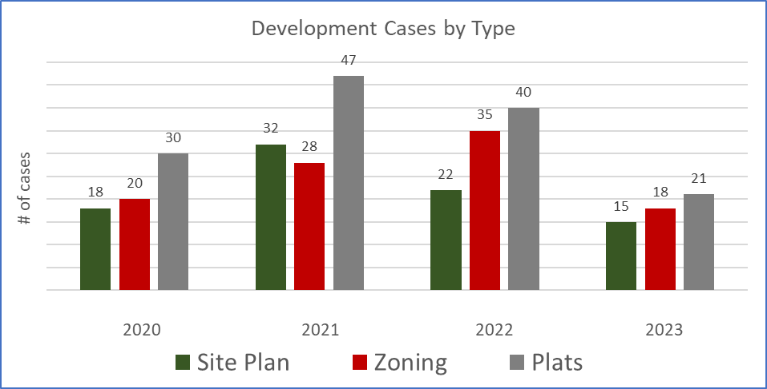
Development Activity

Slide 6
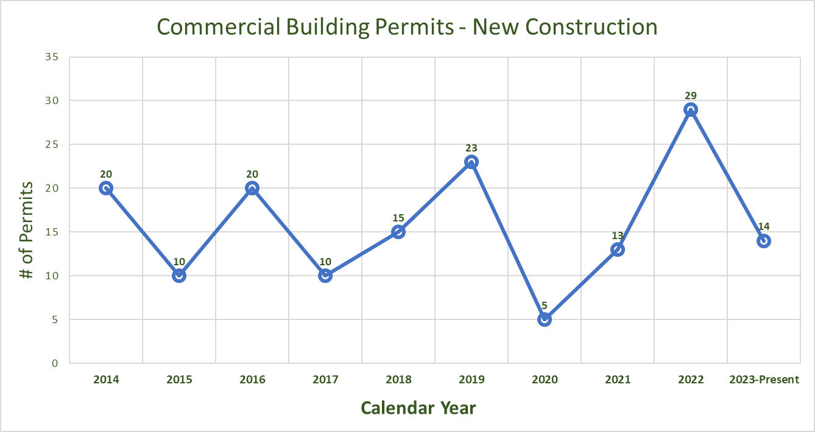
Commercial New Construction Permits

Slide 7
Commercial
Large or significant developments including hotels, retail, or other projects of interest
Name | Address | Status
Fredericksburg Middle School Campus | Friendship Ln | Under Construction
The Emigrant | E Main St | Expect CO in 2023
Albert Hotel | E Main St | Under Construction (new contractor)
Grand Central at Milam | N. Milam | Under Construction 4 Businesses Open
Vineyard Hills RV (Chateau Burg) | Hwy 16 S | Under Construction 142 RV slots
Friendship Lane Hotels | Friendship Ln (behind Wal Mart) | 3 Hotels on 22 ac – Site Plan approved
Smitty's Car Wash at 513 S. Adams | S. Adams | Expect CO in 2023
Office Park | 1403 E Main | Building Permit Issued

Slide 8
Commercial
Large or significant developments including hotels, retail, or other projects of interest
Name | Address | Status
Sunset Grill |  | Under Construction
Woerner's Warehouse |  | Complete
Six Twist | 525 E Main | Complete
H-Tea-0 (drive thru) 1511 E. Main | E Main | Under Construction
Surgery Center | 811 S. Milam | Building Permit Issued
Shopping Center (Sherwin Williams, T-Mobile, third tenant) | 1455 E. Main | Permit Pending GC
Mi Pueblo (former Campo Azul) | 803 S. Adams | CO Issued
Brooke’s Bubble Bar | E Main | Expect CO in December

Slide 9
Single Family Residential Subdivisions
Name | ~ Acres | Units | Status | Year Approved
Crabapple Grove | 40 | 159 | All lots sold | 2015
Oaks of Windcrest Heights of Windcrest | 70 | 243 | All lots sold All lots sold | Phase 5 2020
Madrona | 13 | 54 | All lots sold | 2022
The Beginning | 11 | 52 | All lots built out
Harmony Hills | 21 | 72 | Under construction | 2023
Post Oak Village | 6 | 39 | Homes under construction | 2022
Friendship Oaks (4 phases) | 117 | 418 | Phase 1 under construction (15 houses permitted) | 2022
Frieden | 218 | 112 | Homes under construction | 2022
Woodcrest | 3 | 9 | Utilities under construction | 2023
Altstadt Phase 1 | 10 | 22 | Development for sale | 2022
Altstadt Phase 2 | 6 | 19 | Civil plan review
Stoneridge Phase 11 | 11 | 24 | Homes under construction | 2022
W. Walch |  | 5 | Plat approved | 2023
              1228 total lots

Slide 10
Single Family Residential Permits

Slide 11
Multi-Family: Under Construction
Name | Acres | Units | Status | Location
Algarita | 3 | 23 | Older section open | 619 W. Live Oak
Baron's Park Apts | 4 | 88​ | Under Construction | 202 E. Ufer
Orchard Grove Apartments | 5 | 90 | Under Construction | N. Llano
The 1846 Luxury Apts & The Woodland Cottages | 18 | 296 | Under Construction | 175 Friendship Lane
West Live Oak Duplexes | 2.4 | 46 | Under Construction | W. Live Oak
 |  | 543

Slide 12
Multi-Family: Recently Completed
Name | Acres | Units | Status
Algarita Eagle's Village (STRs) | 3 4 | 40 24 | Old section open (new under construction) Completed
Vineyard Crossing Apartments | 3 | 38 | Completed
Friendship Lane Cottages (STRs) | 1 | 8 | Completed
 |  | 110

Slide 13
Multi-Family: Approved Not Started
Name | Acres | Units | Status | Location
Friendship Oaks Ranch duplexes | 6 | 60 | Site Plan Approved | S. Creek at Friendship (Friendship Oaks Phase 4)
SECO | 32 | 95 | Civil Plan Approved | Friendship at S. Eagle
Botanica | 13 | 148 | Civil Plan Approved | Friendship near Eagle
Keller Oaks Phase 1 Townhomes | 14 | 21 | Plat Approved | Between Windcrest and Burger King
Verandas at Frieden | 25 | 305 | Site Plan Approved | Frieden
Alora Mae Condos | 3.5 | 21 | Conditional Use Permit Approved | Friendship
 |  | 650

Slide 14
Multi-Family:
543 Under Construction
110 Recently Completed
650 Approved not started
1,303 total Multi Family units

Slide 15
Short Term Rentals
Permit Status
Active – 806
Withdrawn – 29
Closed-31
Pending – 124
Under Review – 112
Expired-189
Denied – 52
Total Reviewed– 1326
Permit Type
STR Accessory – 11​
STR B&B – 2​
STR Condo- 3
STR Facility – 10
STR Unoccupied – 49
Nonconforming – 1241

Slide 16
Public Works
East Main Street Water Line Project
Project limits: Cristal Drive (by UPS Store) to Baron’s Creek Bridge (Natural Grocers side of bridge)
  Project Construction Complete

Slide 17
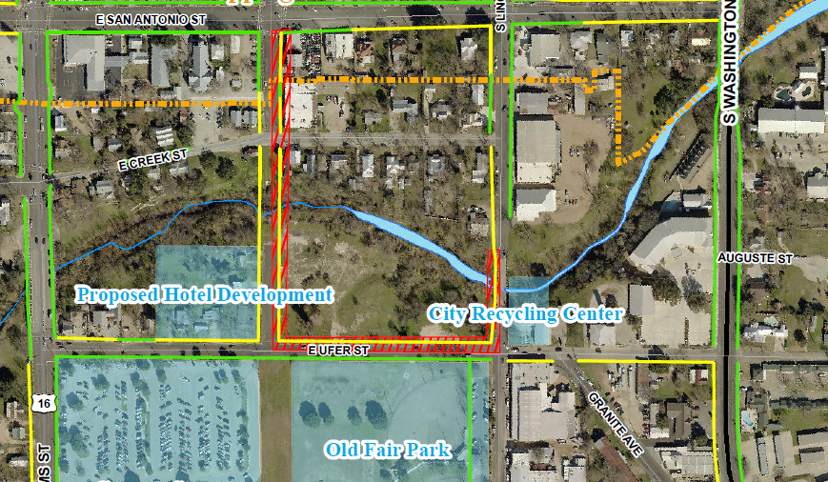
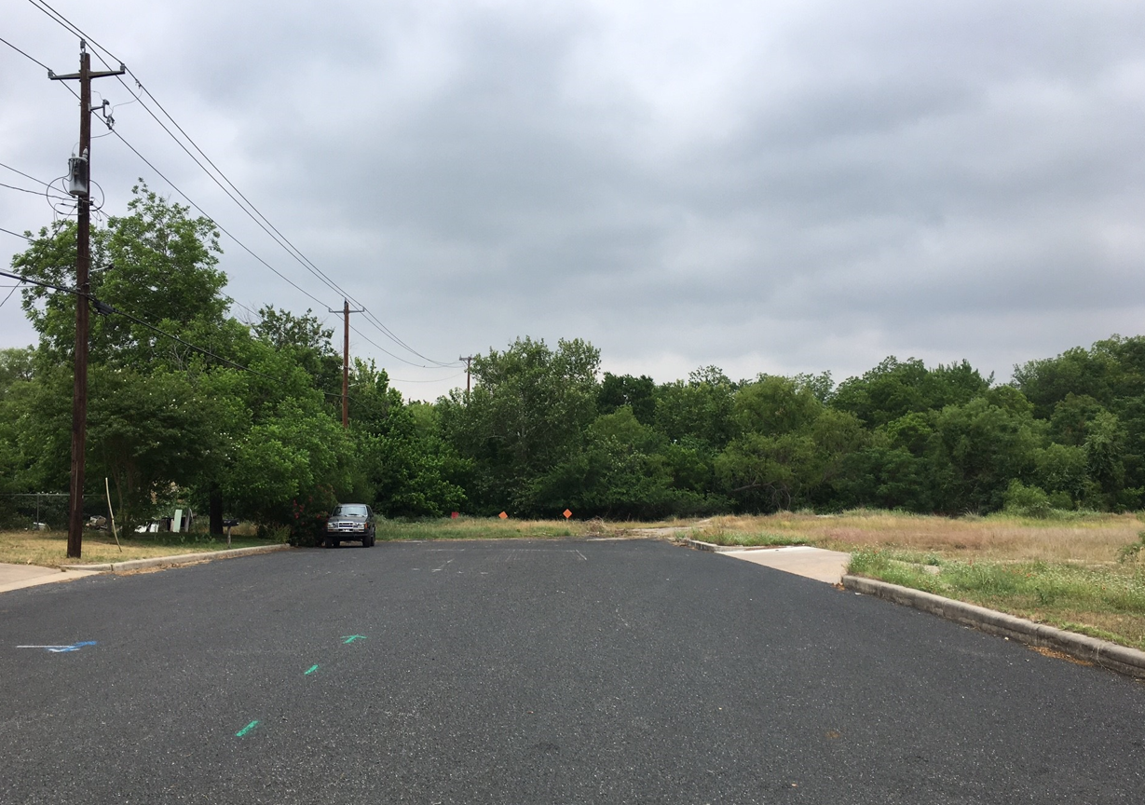
Public Works
South Llano Shared Use Bridge & Ufer St. Sidewalk
Project limits: S. Llano St. from San Antonio St. to Ufer St.
  Construction Contract Awarded to J3 Company, LLC
  $1,117,530 Contract Amount ($902,748 in Grant Funds)
  Completion Anticipated in Summer 2024.

Slide 18
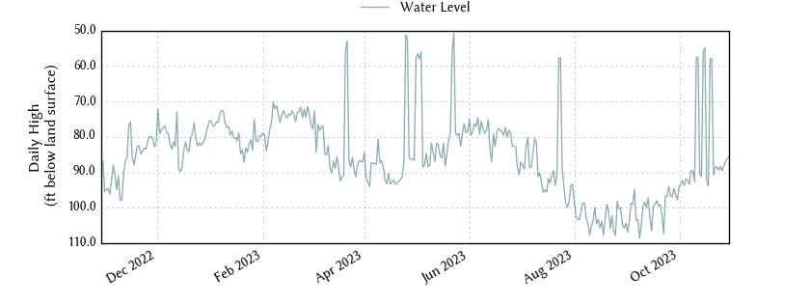
Public Works
Knauth Wells – Aquifer Level (*As of November 13)

Slide 19
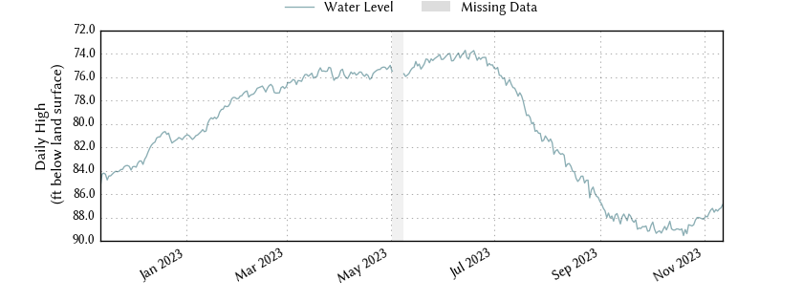
Public Works
Old San Antonio Road Wells – Aquifer Level (*As of November 13th)

Slide 20
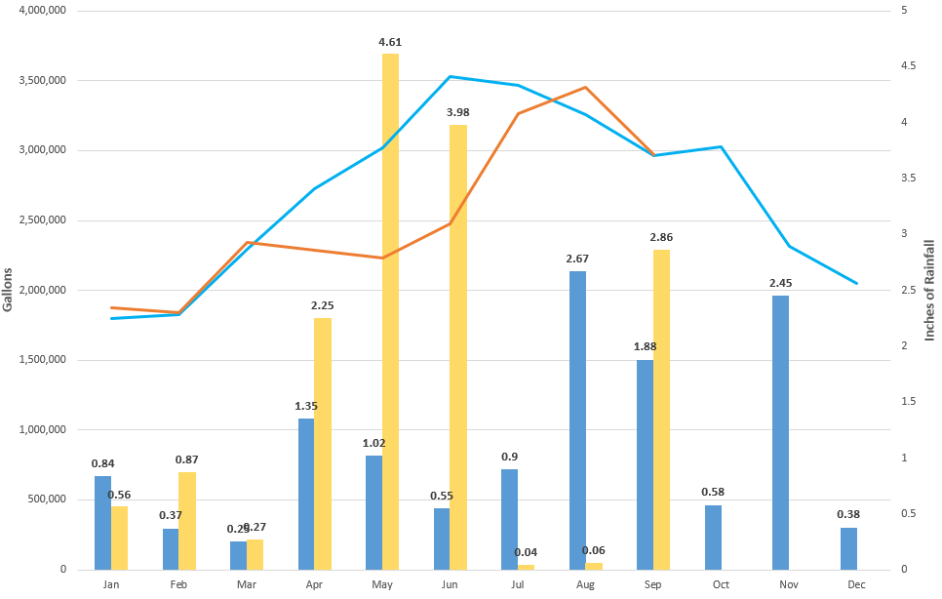

Public Works
Pumping Rates and Rainfall
2022 Total Rainfall – Inches
2023 Total Rainfall – Inches
2022 Daily Avg. Pumping – Gal
2023 Daily Avg. Pumping – Gal

Slide 21
Parks
Project | Budget | Paid to date | Notes
Marktplatz renovations | ~$2M | $1,594,321 | Scheduled completion December 2023
Workman with sprayer | $84,000 | $0 | Delivery pending – funds moved to FY '24
Parks Master Plan | $80,000 | $52,000 | $28,000 moved to FY '24
Marktplatz restroom renovations | $65,000 | $0 | Waiting on estimates
Pioneer Pavilion renovations | $150,000 | $0 | Working on estimates
Old Fair Park storage | $40,000 | $0 | Working on estimates
LBJMP Restroom replacement | $330,000 | $0 | Order placed – to be installed July 2023
Marktplatz storage expansion | $48,000 | $0 | Working on estimates

Slide 22
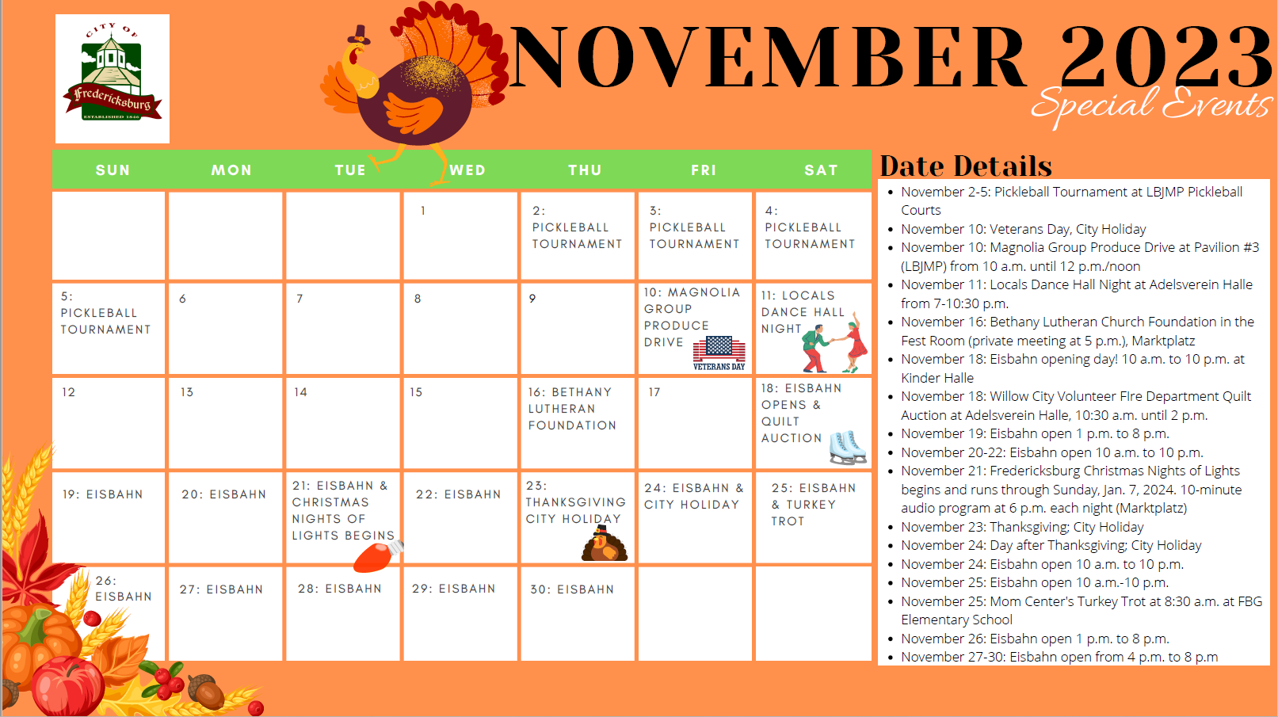
Parks

Slide 23
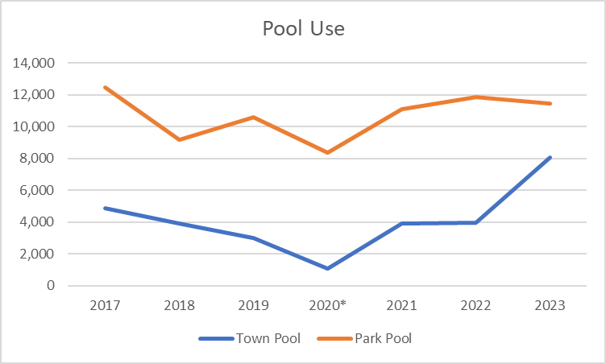
Parks
*Covid

Slide 24
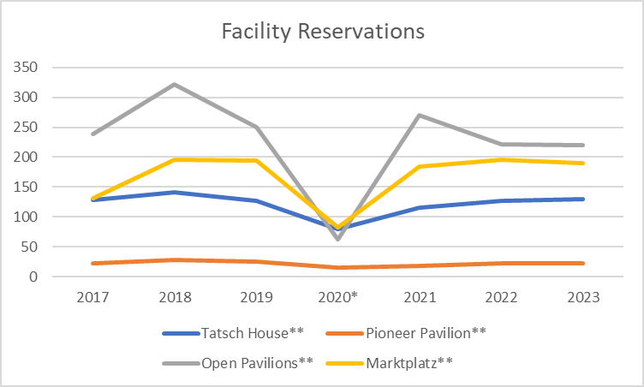
Parks
*Covid
**2023 Projections

Slide 25
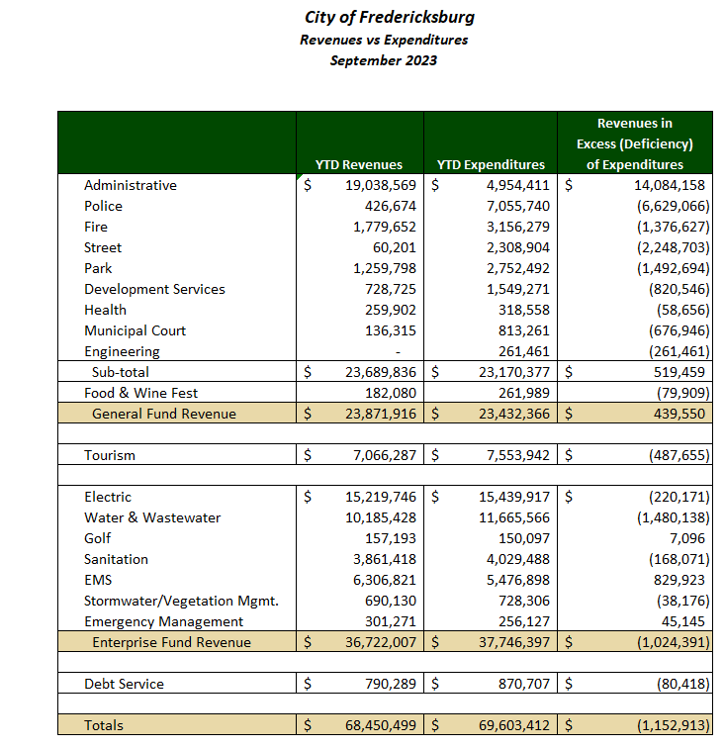
Finance-Revenue vs Expenditures (Actuals - through September 2023)
General Fund
Actual vs Budget
107% of Revenue 89% of Expenses
Enterprise Funds Actual vs Budget
108% of Revenue 92% of Expenses
Notes:
Budget: GF REV $22,363,060, EXP $26,442,911, ENT REV $34,102,852, EXP $40,818,773
Tourism REV $7,047,200 (49%), and EXP $7,819,785 (56%)

Slide 26
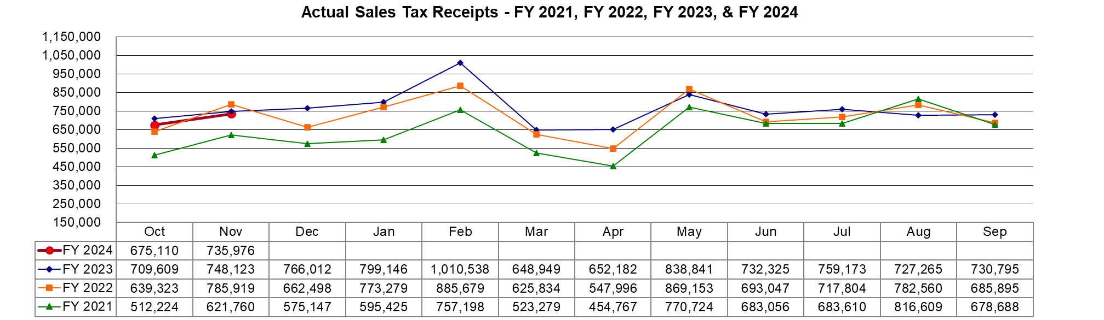
Finance-Sales Tax
FY 2024 Actuals down 3.2% from 2023
FY 2023 Actuals up 5.2% over FY 2022 at $9.1M collected
$8.7M (2022), $7.6M (2021)

Slide 27
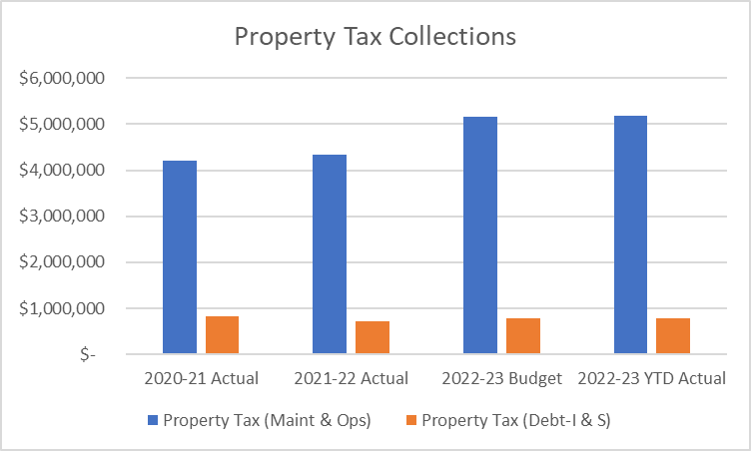
Finance-Property Tax
Property Tax Collected (thru Sept 2023)
Actual $5,971,764
Budget $5,945,651

Slide 28
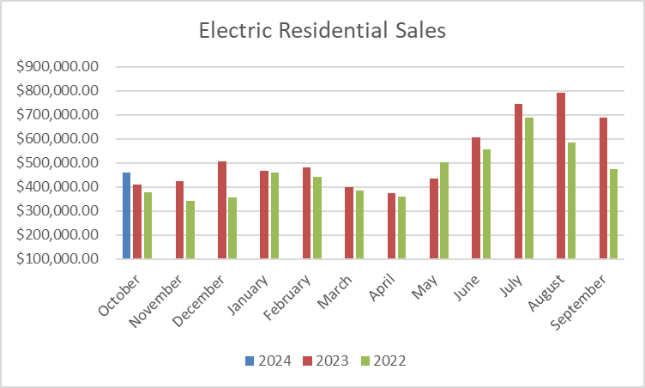
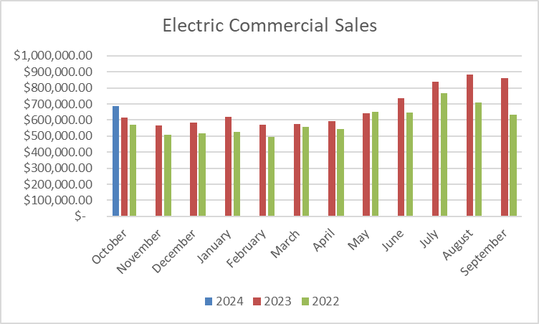
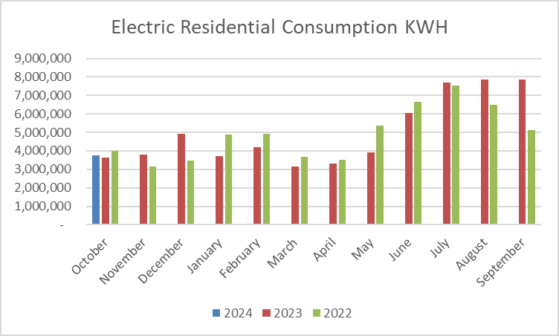
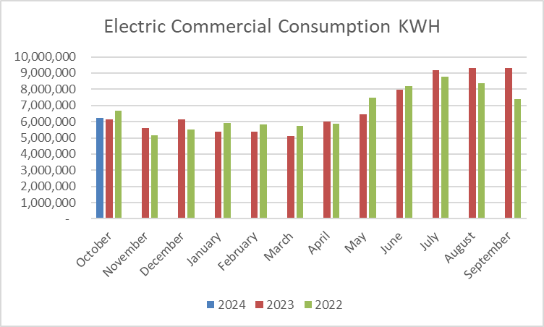
Finance-Electric Revenue and Consumption
Electric revenues October 2023 (preliminary), $1.1M,
8% of $14.7M budget

Slide 29
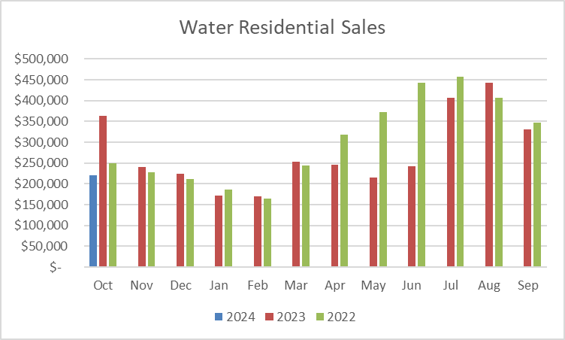
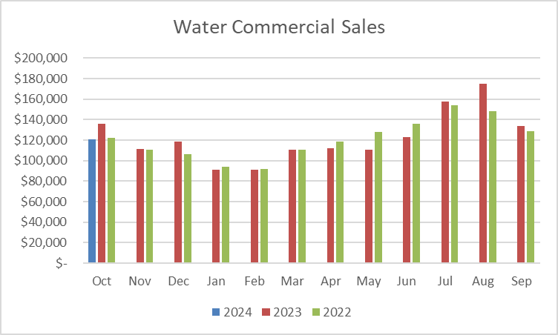
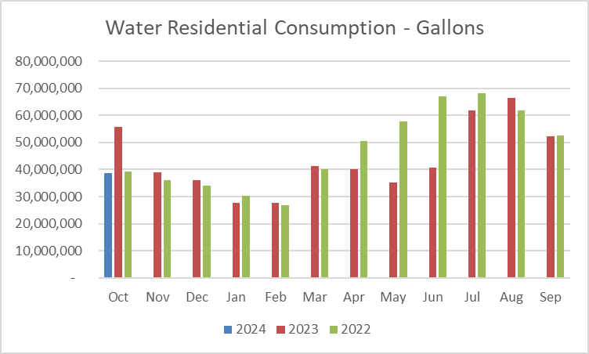
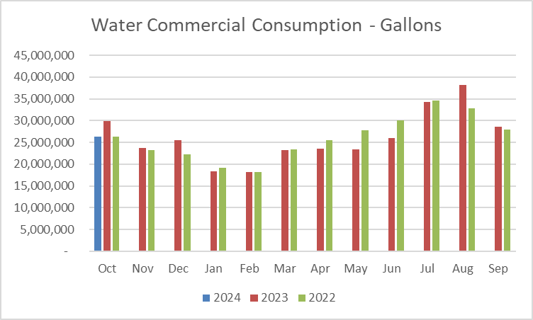
Finance-Water Revenue and Consumption
Water & WW revenues October 2023 (preliminary), $859k, 9% of $9.5M budget

Slide 30
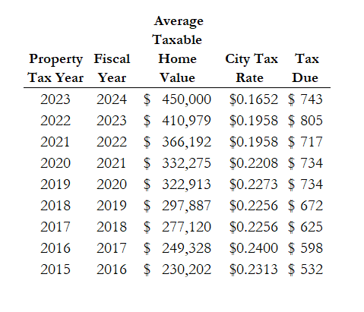
Finance-Property Tax
Property Tax Trends (FY 2016 – FY 2024)
Notes:
FY 2023 $62/month

Slide 31
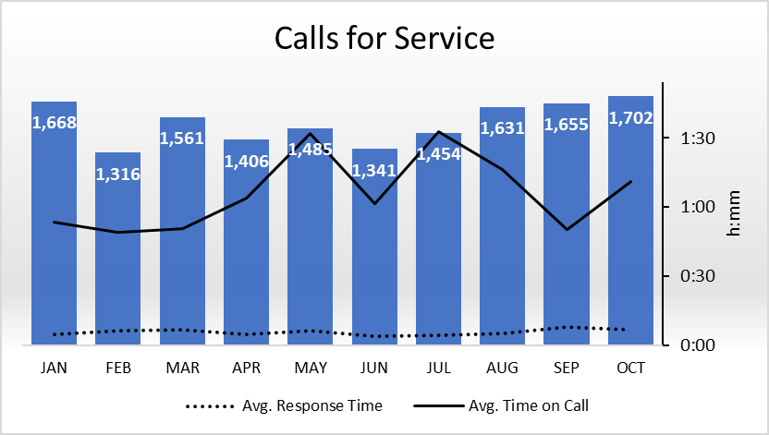
Police Department
October 2023 Calls for Service – 1,702

Slide 32
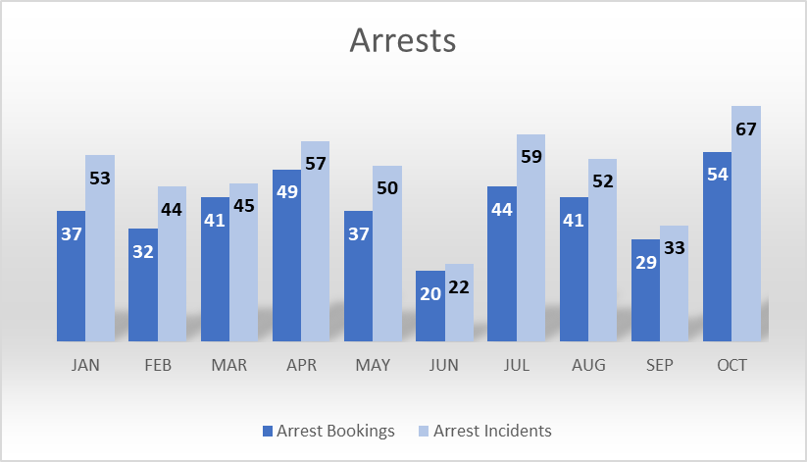
Police Department
October 2023 Arrests
  54 Individuals Booked
  67 Total Charges

Slide 33
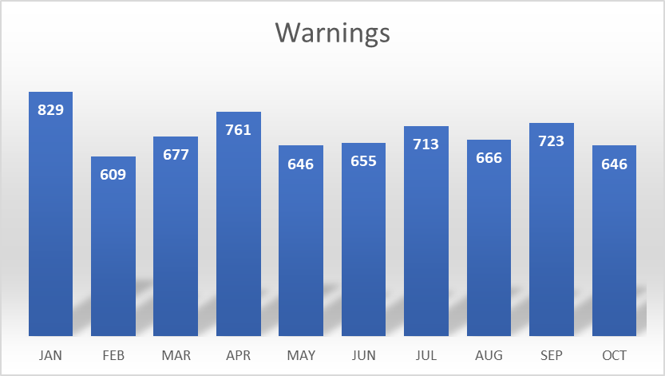
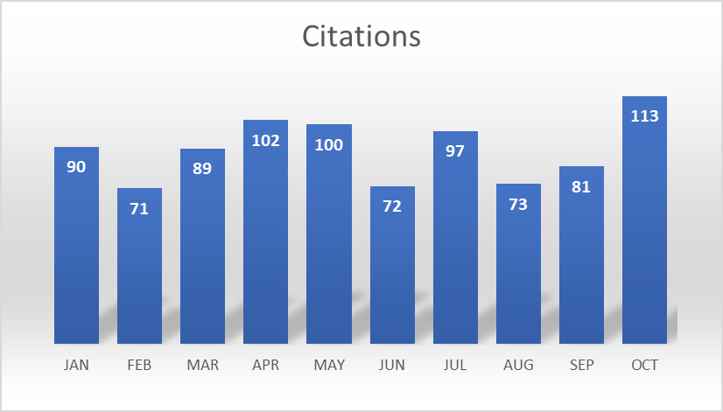
Police Department
October 2023 Warnings and Citations - 759
  646 Warnings
  113 Citations

Slide 34
Police Department
October 2023 Code Enforcement Activity -
  -- of the --- were STR Activity

Slide 35
Police Department
January - October 2023 Code Enforcement Totals
1,438 Code Enforcement Violations
1,013 Non – STR
425 STR

Slide 36
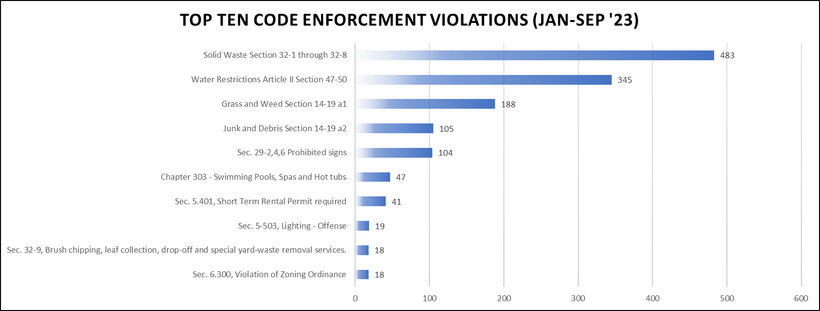
Police Department
January - September 2023 Code Enforcement Top 10

Slide 37
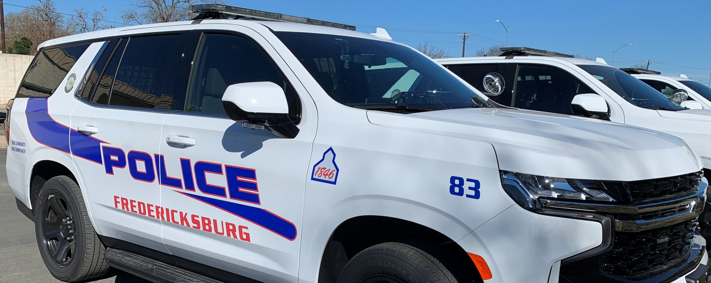
Police Department
October 2023 Traffic Accidents - 72
  61Minor Accidents
  11 Major Accidents

Slide 38
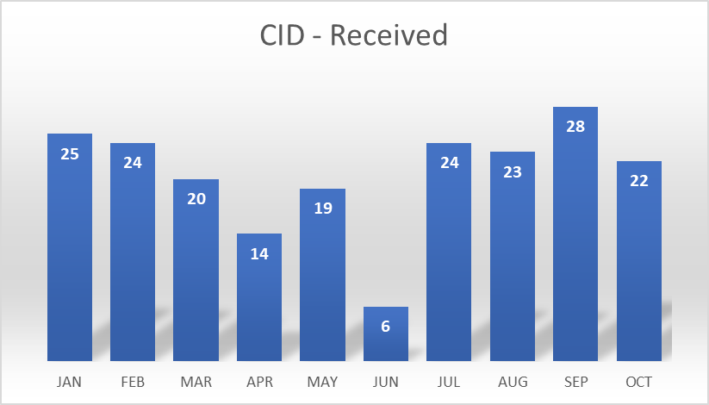
Police Department
October 2023 Criminal Investigations Activity
  22 Cases Received
  9 Cases Cleared
  13Cases Under Investigation

Slide 39
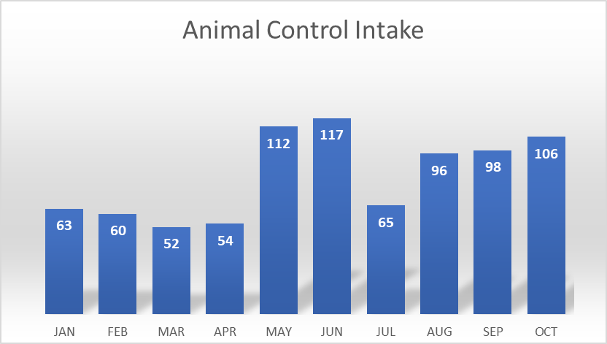
Police Department
October 2023 Animal Control Intake – 106
  47 Dogs 59 Cats
  15 Animals Reclaimed or Adopted
  40 Dead Animals Picked Up

Slide 40

Oct 2023
RMS Report

Slide 41
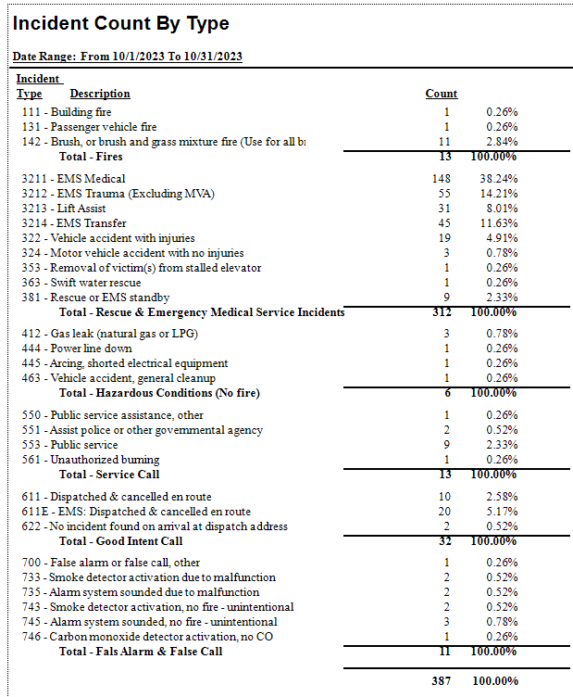

Slide 42
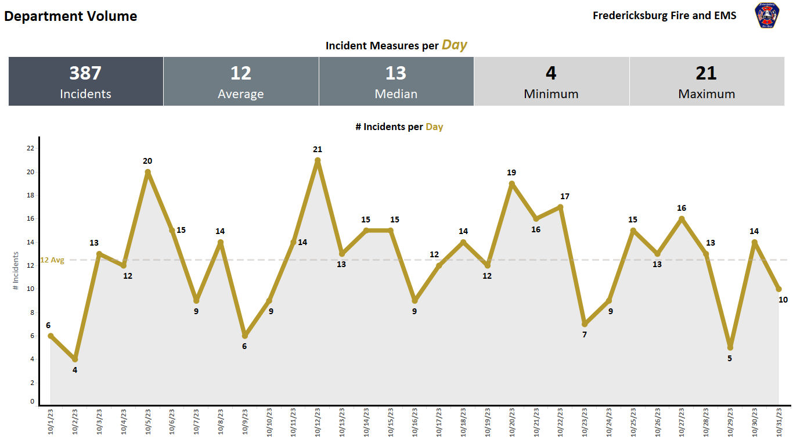

Slide 43
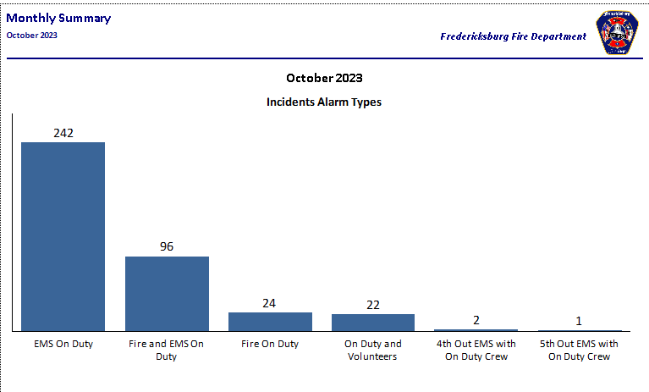

Slide 44
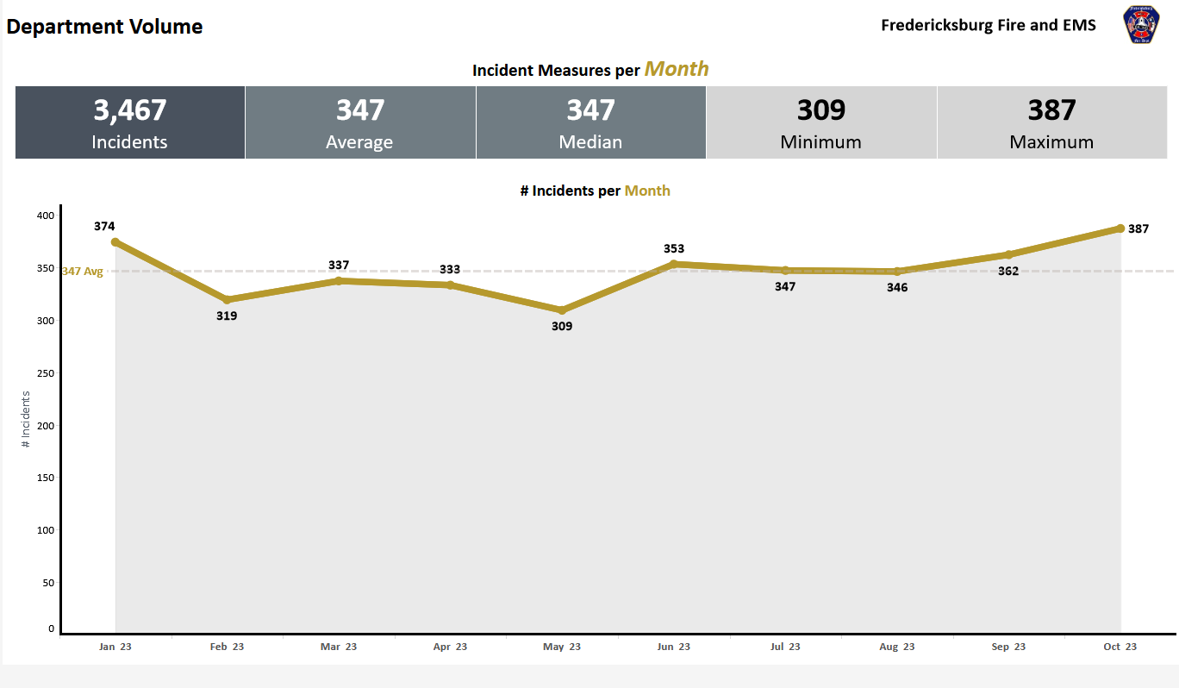

Slide 45
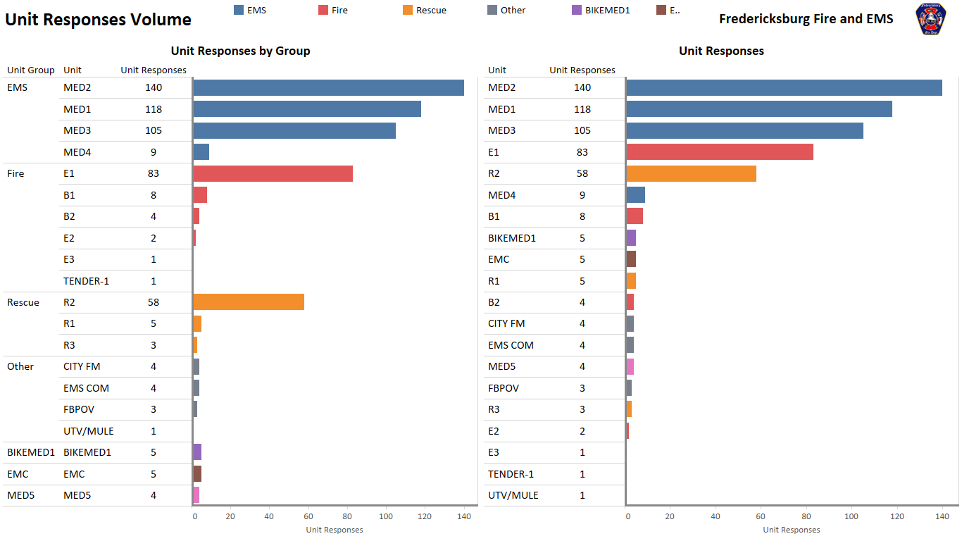

Slide 46
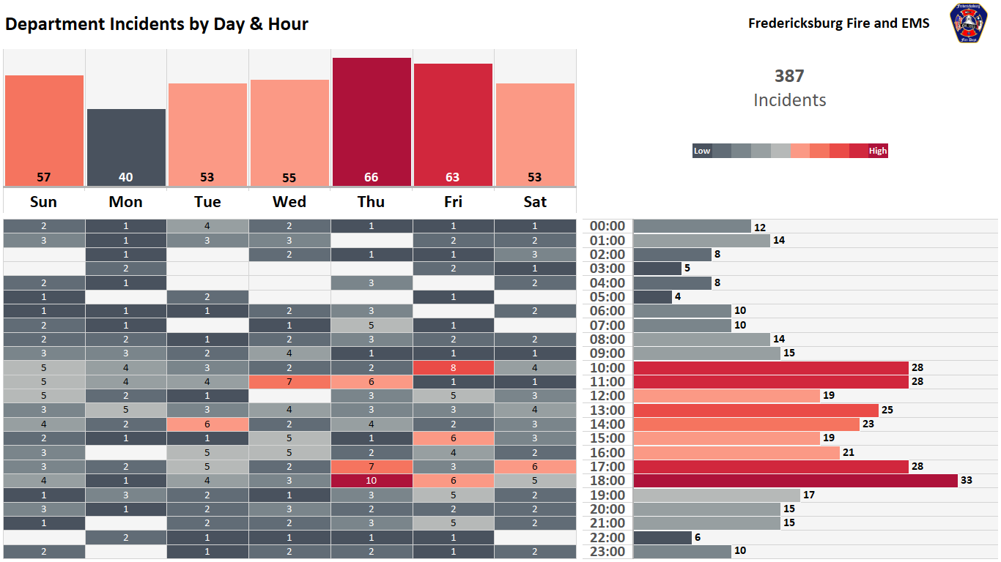
11/Day
8/Day
11/Day
14/Day
17/Day
16/Day
13/Day

Slide 47
2022-23 Transfers Per Month

Slide 48
2022-23 Brush
Fire Season

Slide 49
2023 Brush Fire Season

Slide 50
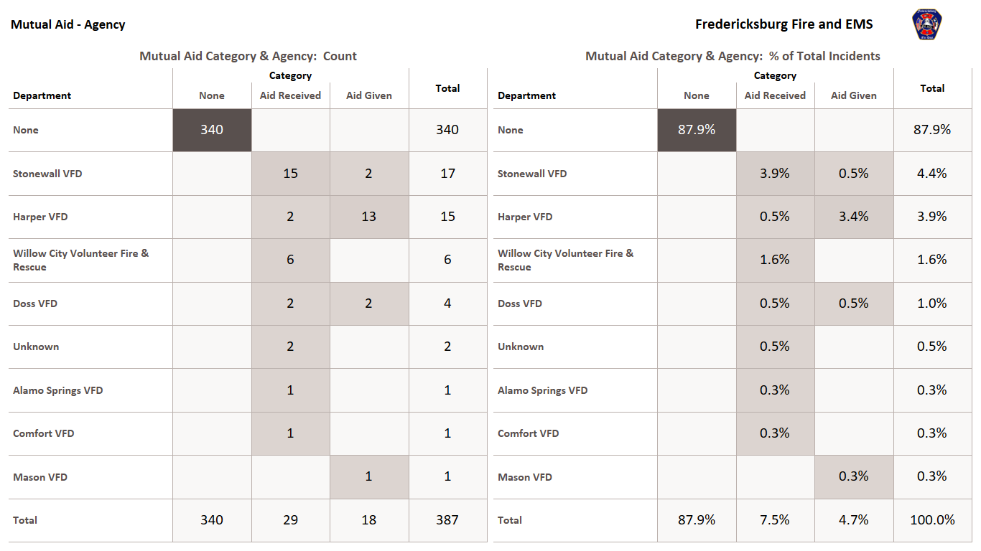

Slide 51
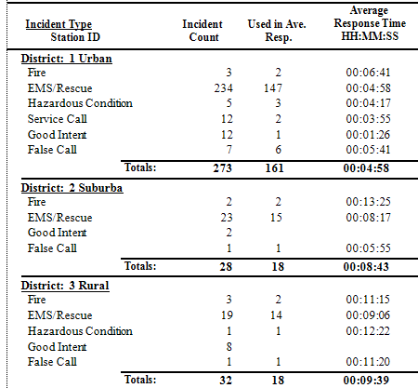
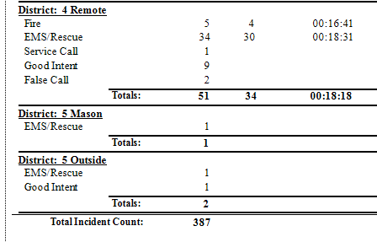

Slide 52
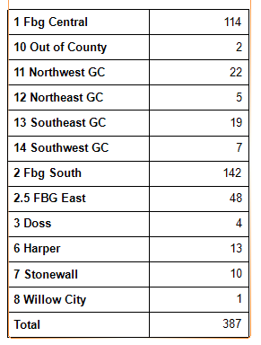

Slide 53
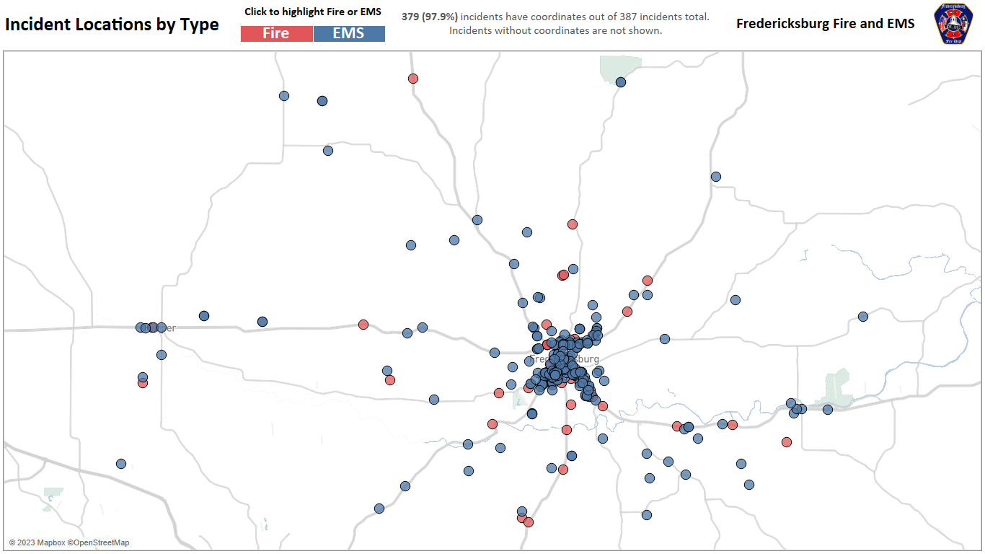

Slide 54
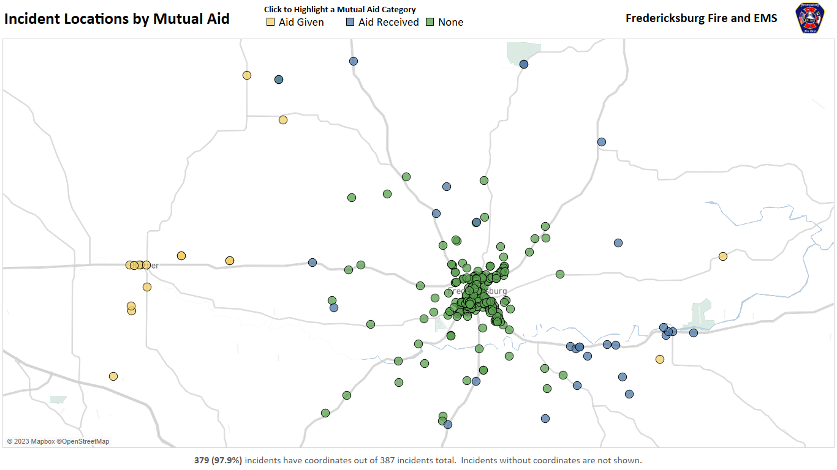

Slide 55
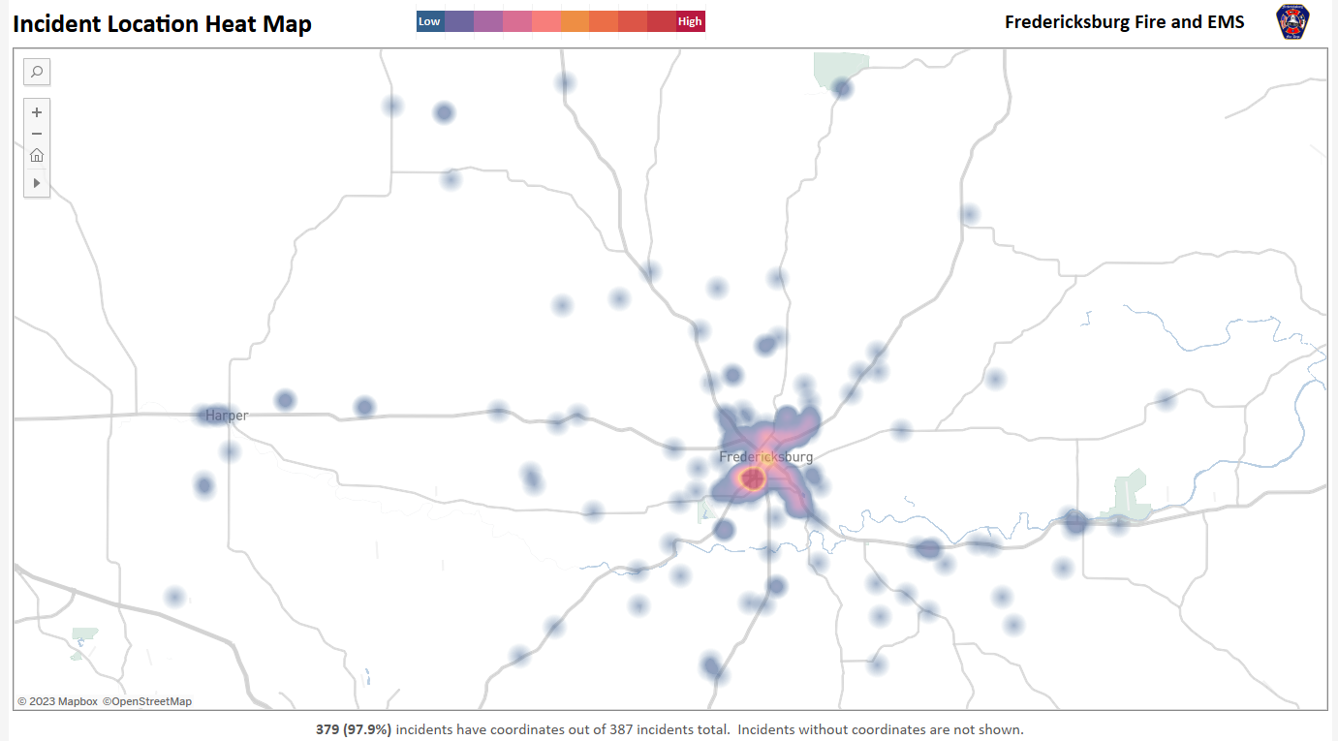

Slide 56
Health Department
September 2023 Health Department Activity
1 - New Retail Health Permit (Fixed Establishment)
6 - New Mobile Health Permits
14 - Temporary Health Permits
64- Routine Inspections performed
3 – Plan Reviews completed
Special events inspected – Redbud Artisan Market, Lutheran Fall Festival and Fredericksburg Trade Days
Attended hearing on Wine Country Mass Gathering
Participated in community childcare meeting

Slide 57
Health Department
September 2023 Health Department Development
5- Plan Reviews completed in September
34- Facilities with plan reviews completed but not yet finished or permitted (20 within city limits and 9 in county)
21 – Facilities being considered or planned

Slide 58
City Department Openings
Open Positions – November 21, 2023
Fire/EMS Department - Captain (Promotional testing process is being scheduled)
- Fire Fighter / Paramedic
Police Department - 3 Police Officers
Water Department - Crew Worker
- Journeyman Electrician
Engineering - Staff Engineer
Street Department - Heavy Equipment Specialist
Development Services - Senior Planner / Historic Preservation Officer
Sanitation - Equipment Operator
Vegetation Mgmt - Apprentice Arborist
12 open positions

Slide 59
City Department Openings
Recently Filled Positions
Apprentice Arborist – Caleb Cannon
Recent Promotions
Quinten Moellering – Crew Chief (Water Dept)

Slide 60
Civic Engagement
Neighborhood Town Hall Meeting-Pioneer Museum Sanctuary
October 12th
  20 residents, 4 Councilmembers and 8 Staff
  Short Term Rental issues
  Development and water concerns
  Traffic issues
Coffee with the City Manager
October 18th at 8:00 a.m. at the Lady Bird Johnson Golf Course in the Cardinal Room

Slide 61
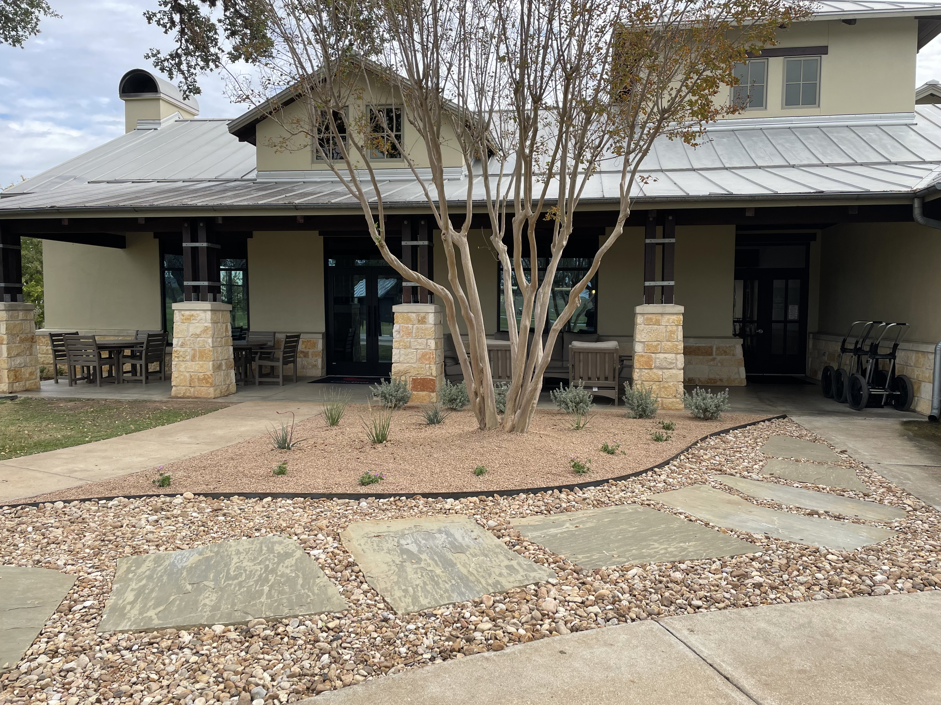
Golf Course Improvements

Slide 62
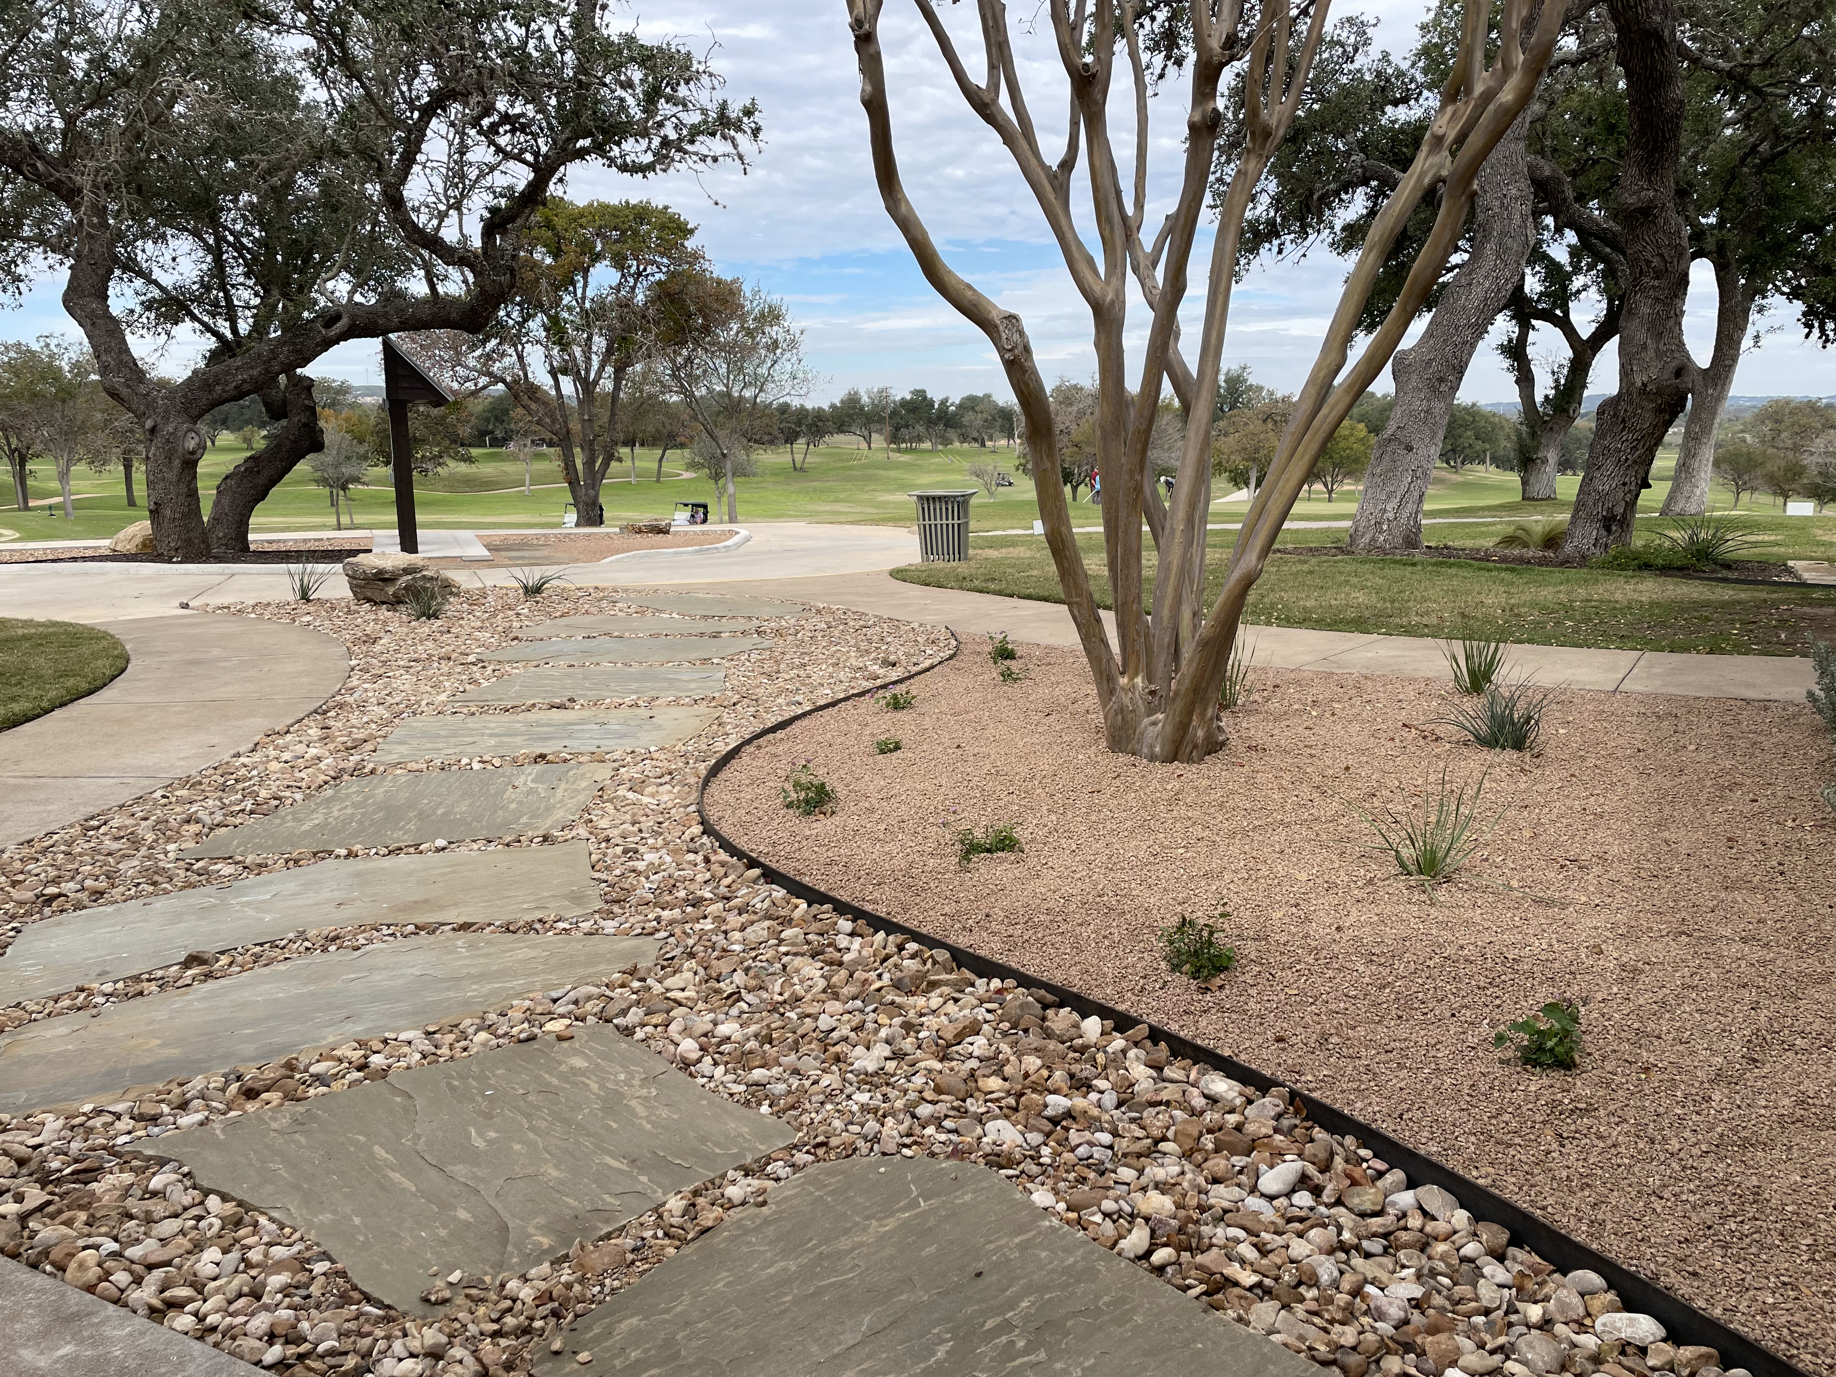
Golf Course Improvements

Slide 63
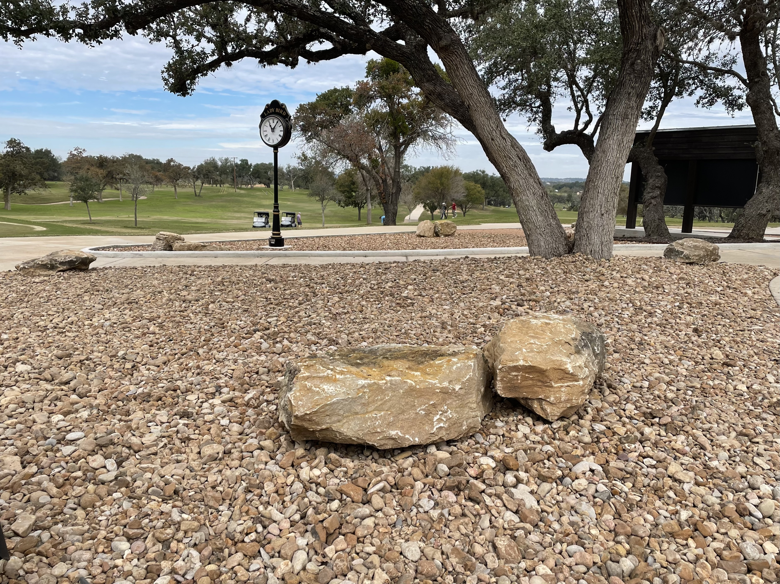
Golf Course Improvements

Slide 64
Fredericksburg Citizen University

